Slide 1
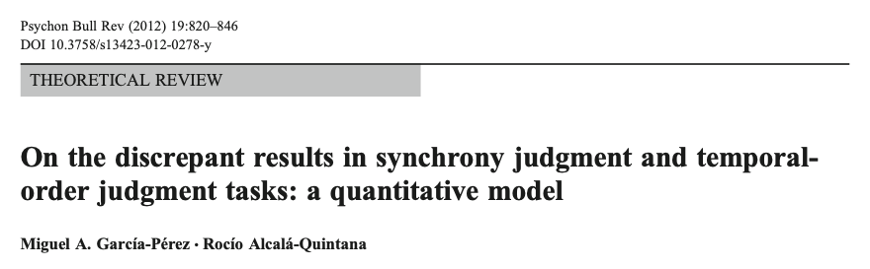
Notes:
The paper I am presenting today is about a generalized model that can be used to fit the data for three tasks: TOJ, SJ, and ternary tasks. They are often used in studies that investigate temporal perception.
Why am I presenting such an old paper? Because Luhe is going to start a project about temporal recalibration, and this paper seems useful for developing the experiment. Even though I don’t agree with the conclusion this paper makes, but I still think this paper is valuable in a sense that it gives us an idea for how to think about these tasks in a sensory level.

Slide 2

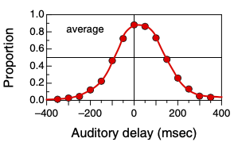
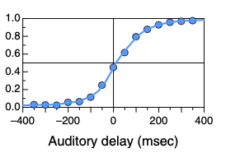
TOJ, SJ, Ternary tasks
Time
+
+
+
+
+
SOA: various
Temporal order judgment (TOJ)
Which stimulus came first (V or A)?
Notes:
In all these three tasks, participants are presented with an auditory and a visual stimulus in each trial. This is an example time line. The visual stimulus is a flash of light, and the auditory stimulus is a brief sound burst. There is a temporal offset between them, a.k.a., stimulus onset asynchrony, which can have various levels.
In the temporal order judgment TOJ task, participants are asked to report which stimulus came first (visual or auditory). Most studies normally take the onset of the visual stimulus as a reference point, and define the relative onset of the auditory stimulus as an independent variable, as shown in this figure, the x-axis. Positive values mean the auditory stimulus occurs after the visual, and negative means before the visual.
Y-axis is the proportion of reporting the visual first. When the auditory precedes the visual by a lot, the proportion of visual-first-response is very low, and then increases as the auditory lag goes up.

Slide 3
TOJ, SJ, Ternary tasks
Time
+
+
+
+
+
SOA: various
Temporal order judgment (TOJ)
Which stimulus came first (V or A)?
Synchrony judgment (SJ)
Did the stimuli appear to be synchronous or asynchronous?
Notes:
In the synchrony judgment task, participants report whether they perceive the visual and the auditory stimuli synchronous or asynchronous. This red curve shows the proportion of synchronous responses as a function of the relative onset of the auditory stimulus. It is the highest when the auditory is close to the visual in time.

Slide 4
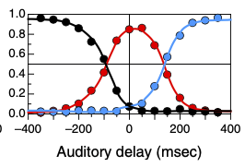
TOJ, SJ, Ternary tasks
Time
+
+
+
+
+
SOA: various
Temporal order judgment (TOJ)
Which stimulus came first (V or A)?
Synchrony judgment (SJ)
Did the stimuli appear to be synchronous or asynchronous?
Ternary task (SJ3)
Whether the auditory stimulus was presented before, after or at the same time as the visual stimulus?
Notes:
The ternary task is a hybrid of first two. In this task, participants are asked to report whether the auditory comes first, or after the visual stimulus or they come at the same time? So this is a 3 alternative forced choice.
The probability of each response is plotted as a function of relative auditory onset. The black one is for auditory-first responses. It starts off high when the auditory stimulus occurs way before the visual stimulus, and then it drops. The blue line is for visual-first responses, and the pattern is the opposite. The red one is for synchronous responses.

Slide 5
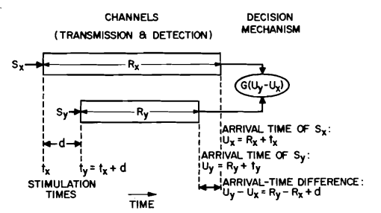
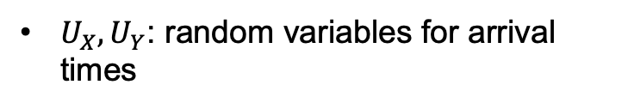
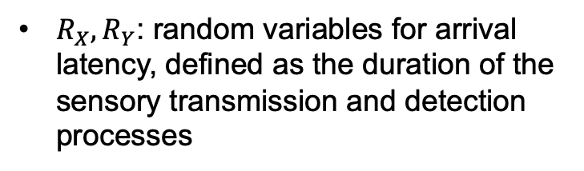
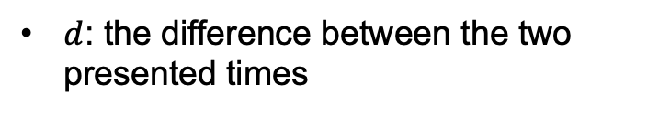



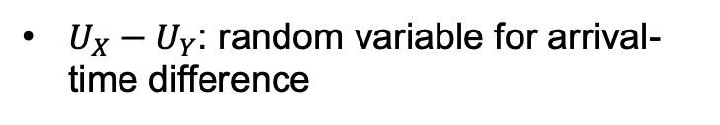
Independent-channels model
$S_{X},$ $S_{Y}$: Stimuli from different modalities
$t_{X},$ $t_{Y}$: the presented physical time
$d$: the difference between the two presented times
$R_{X},R_{Y}$: random variables for arrival latency, defined as the duration of the sensory transmission and detection processes
$U_{X},U_{Y}$: random variables for arrival times
$U_{X}−U_{Y}$: random variable for arrival-time difference
$G$: decision function
Sternberg and Knoll (1973)
Notes:
Before I talk about the model in this paper, I want to first quickly go over the two models that the model in this paper is based on. The first one is called independent channels model. It’s used for determining the temporal order of two stimuli from different modalities.
This figure explains the model. The two s’s represent the stimuli, and they are presented at time tx and ty respectively, with a physical temporal lag between them, denoted as d. Rx, Ry are random variables for arrival latency. When signals occur in the environment, it takes time for our sensory systems to detect the signals. The duration from the onset of the signal to the time point it gets detected by our sensory systems is defined as arrival latency.
Ux and Uy are also random variables; they represent the arrival time of the two signals, R+t. The difference between Ux and Uy is what we interested in, the arrival-time difference. And this random variable is then passed into a decision function G to determine the temporal order of the two signals.
This model is called independent-channels model because it assumes that the sensory channels are separate and independent in a sense that activity in one channel is not influenced by what activity occurs in the other channel, or WHEN it occurs in the other channel. So the arrival latency Rx Ry have no influence on each other.

Slide 6
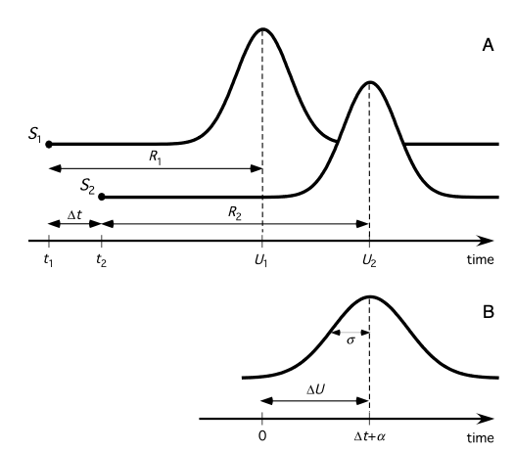





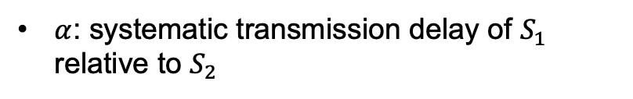

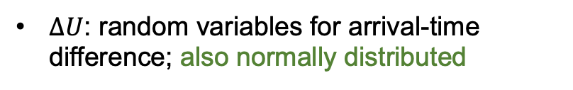

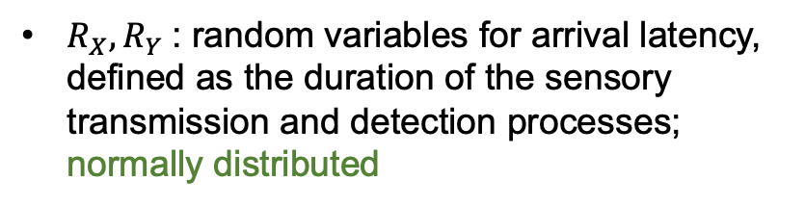

Triggered-moment model
$R_{X},R_{Y}$: random variables for arrival latency, defined as the duration of the sensory transmission and detection processes; normally distributed
$∆U$: random variables for arrival-time difference; also normally distributed
$α$: systematic transmission delay of $S_{1}$ relative to $S_{2}$
$$δ$$
$$δ$$
$δ$: criterion
$$δ$$
$$δ$$
$$δ$$
Schneider and Bavelier (2003)
Notes:
The other model this paper is based on is called the triggered-moment model. The basic framework of this model is the same as the independent-channels model, except that this model assumes the arrival latency is normally distributed, and therefore the arrival-time difference, \delta_U, is also normally distributed.
Another difference is that the triggered-moment model has an extra parameter alpha used to capture a systematic transmission delay of one signal relative to the other. So this delta_U is centered at the physical timing difference, delta_t, plus this systematic transmission delay, alpha.
The last assumption of this model is that if the arrival-time difference is within a window, participants would perceive them as simultaneous. If they are asked to judge the order, they would just guess.

Slide 7
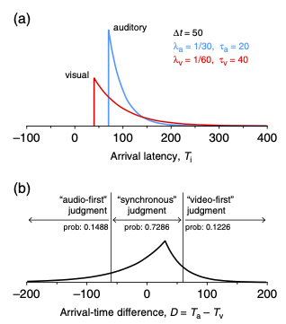

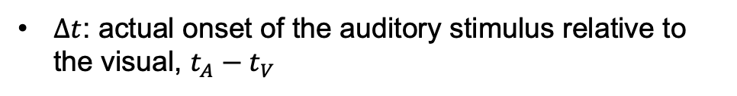
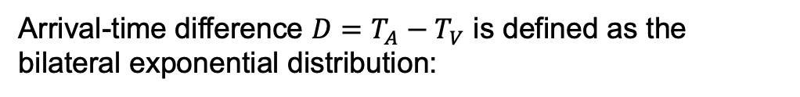
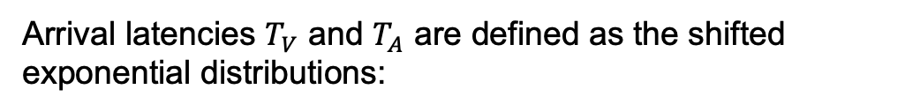
An integrated model for TOJ, SJ, Ternary tasks
Arrival latencies $T_{V}$ and $T_{A}$ are defined as the shifted exponential distributions:
$τ_{A}$, $τ_{V}$: systematic transmission delay
$∆t$: actual onset of the auditory stimulus relative to the visual, $t_{A}−$ $t_{V}$
$λ$: rate parameter
Arrival-time difference ${D=T_{A}−T}_{V}$ is defined as the bilateral exponential distribution:
$τ$: relative systematic transmission delay, $τ_{A}−τ_{V}$
Notes:
That’s enough background I think…
This model in this paper is built based on the independent-channels and triggered-moment models. The major difference is that this model assumes shifted exponential distributions for arrival latencies, as shown in this figure. Tau is for systematic transmission delay for a given sensory modality, and delta_t is the physical onset difference, t_A minus t_V.
Since the physical onset of the visual stimulus is considered as a reference point, the distribution for visual arrival latency won’t be affected by delta_t, it will only be affected by tau_v. In this example here, the red curve for visual is shifted to the right by 40 ms because tau_V is 40. The blue curve on the other hand is shifted to the right by 70, because both delta_t and tau_A can shift this curve.
Lambda is a parameter that controls how fast this exponential distribution decays, in other words, how noisy the arrival latency is for a given sensory modality.
Ok … given these two shifted exponential distributions for arrival latencies, we can compute the distribution for arrival-time difference, which is a bilateral exponential distribution. This is the math for that. With Mike’s help, I tried deriving this function. If any of you guys are interested, I can send you the pdf. In these two equations, there is new notation here, tau, which is tau_a minus tau_v, so it’s relative auditory systematic transmission delay.

Slide 8




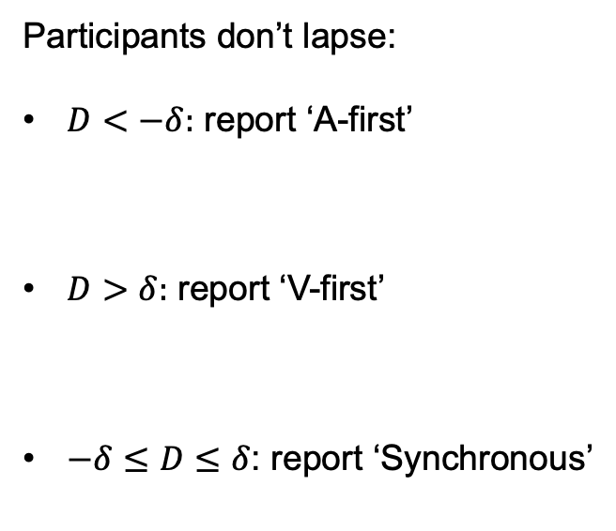
An integrated model for TOJ, SJ, Ternary tasks
Participants don’t lapse:
$D<−δ:$ report ‘A-first’
$D>δ:$ report ‘V-first’
$−δ≤D≤δ$: report ‘Synchronous’
Notes:
Yeah that’s the model. Next, I am gonna go over each of these three tasks and how this model is modified to capture the data from these three tasks.
In the ternary task, if we first assume that participants don’t lapse, meaning they are always attentive to the stimuli and they always press the button they intend to press, then the participants will report ‘A-first’ if the arrival-time difference is smaller than this criterion, so the probability of ‘A-first’ responses is the integral from –infinity to this criterion, -delta. If the arrival-time difference is greater than delta, then participants report ‘V-first’, the probability is this orange area.
In all other cases, arrival-time difference is within –delta and delta, so participants perceive them as synchronous and report ‘synchronous’.

Slide 9
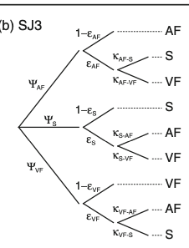




An integrated model for TOJ, SJ, Ternary tasks
Participants do lapse:
report ‘A-first’
Notes:
Now let’s assume participants do lapse, this paper has so many free parameters just for lapses. I honestly don’t think they are all necessary. So this is the diagram they show to describe the probabilities of each of those three responses after taking lapses into account.
So at any given SOA, participants would response ‘A-first’ with this probability, but since they lapse with a probability of epsilon_AF, and when they lapse, they either mistakenly report ’synchronous’ with a probability of kappa_AFS, or report ‘V-first’ with a probability of kappa_AF_VF. These two kappas add up to 1. These two kappas are not set to 50%-50%. I don’t understand why the chance of mistakenly choosing the two unintended responses should be not be the same. Participants don’t lapse with a probability of 1-epsilon_AF, and they repond ‘A-first’ as they intend to do.
The logic for the other two branches are the same, and this model assumes different lapse rates for each response type, epsilon_AF, epsilon_S, and epsilon_VF, which I found unnecessary.
Anyway, there are a total of 6 free parameters in this model just for the lapses.
The formula for the probability of reporting ‘A-first’ is just the sum of all the products from these three branches that lead to the ‘A-first’ response.

Slide 10




An integrated model for TOJ, SJ, Ternary tasks
Participants do lapse:
report ‘A-first’
report ‘V-first’
Notes:
Same logic applied for the formula for the ‘V-first response’

Slide 11




An integrated model for TOJ, SJ, Ternary tasks
Participants do lapse:
report ‘A-first’
report ‘V-first’
report ‘Synchronous’
Notes:
And for the ‘synchronous’ response

Slide 12




An integrated model for TOJ, SJ, Ternary tasks
Participants don’t lapse:
$−δ≤D≤δ$: report ‘Synchronous’
$D<−δ$ or $D>δ$ : report ‘Asynchronous’
Notes:
Next, for the synchronous judgment task, again we first consider the ideal case that participants don’t lapse. They report synchronous if the arrival-time difference is within –delta and delta, so the probability is the integral of this distribution within this range.
And they report asynchronous if the arrival-time difference is outside of these bounds.

Slide 13
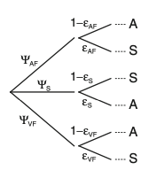
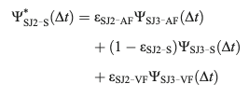



An integrated model for TOJ, SJ, Ternary tasks
Participants do lapse:
report ‘Synchronous’
Notes:
Then if we assume participants they lapse, for this task, there will be three free parameters for lapses, epsilon_AF, epsilon_S epsilon_VF, just as the ternary task. Because there are only two possible responses, ‘synchronous’ and ‘asynchronous’, kappa for the ternary task is not needed.
The probability of getting ‘synchronous’ responses are the sum of the product from these three branches.

Slide 14
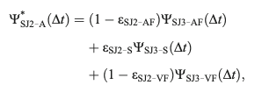



An integrated model for TOJ, SJ, Ternary tasks
Participants do lapse:
report ‘Synchronous’
report ‘Asynchronous’
Notes:
Same for the ‘asynchronous’ response.

Slide 15



An integrated model for TOJ, SJ, Ternary tasks
Participants don’t lapse:
$D<−δ$: report ‘A-first’
$−δ ≤D≤δ$: report ‘A-first’ with a probability $1−ξ$
$D>δ$: report ‘V-first’
$−δ ≤D≤δ$: report ‘V-first’ with a probability $ξ$
Notes:
For the TOJ task, when participants don’t lapse, they report ‘A first’ if D lands on the left side of –delta. Participants also respond ‘A-first’ with this probability when D lands within these bounds. This is because the model assumes participants perceive the two stimuli as simultaneous if the arrival-time difference is within this range, so they have to randomly pick between ‘A-first’ and ‘V-first’ responses in this case.
This free parameters can also capture participants biases in choosing this response if there are any. But I don’t think this free parameter is necessary. It might be possible that people have tendency of choosing synchronous over asynchronous responses or the other way around, but it’s hard to imagine people have biases over ‘A-first’ or ‘V-first’. Having this free parameter is a terrible idea because it trades off with other free parameters in this model. We will come back to this when we get to parameter estimates.
Anyway, the probability of reporting ‘V-first’ is formulated similarly.

Slide 16
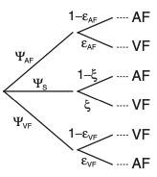




An integrated model for TOJ, SJ, Ternary tasks
Participants do lapse:
report ‘A-first’
Notes:
For the TOJ task, there are two lapse rates, epsilon_AF, and epsilon_VF. Again the probability of reporting ‘A-first’ is the sum of the product from these three branches.

Slide 17




An integrated model for TOJ, SJ, Ternary tasks
Participants do lapse:
report ‘A-first’
report ‘V-first’
Notes:
Same logic for the probability of reporting ‘V-first’.

Slide 18
An integrated model for TOJ, SJ, Ternary tasks
Free parameters:
Ternary task (SJ3)
+7 alternative models
Synchrony judgment (SJ)
+7 alternative models
Temporal order judgment (TOJ)
+3 alternative models
Data:
Eijk, Kohlrausch, Juola, & Van de Par, 2008
Audiovisual stimuli: 1. flash-click; 2. bouncing ball
Model fitting: Maximum likelihood estimation
1. Separate fit
2. Joint fit
Notes:
Here is a summary for all the free parameters for these three tasks. The first four parameters are included in all these three tasks. The ternary task has the most free parameters for lapses. The lapse rate is different for each intended response, and for each unintended response.
They also tested 7 alternative models, in which either one, or two or all of these three epsilons are set to 0. Because they think that fitting these parameters only makes sense if they differ meaningfully from 0. So they fit 8 models to the data from the ternary task, and then pick the one that has the lowest BIC value.
For the synchrony judgment task, again they tested 7 alternative models, and picked the one that has the lowest BIC value for each participant.
For the temporal order judgment, three alternative models are tested, either one or both epsilons are set to 0.
The data used for testing the model is recycled from another paper. In that study, there were two different audiovisual stimuli: flash-click and bouncing ball. Participants completed TOJ, SJ and ternary tasks with both stimuli.
To fit the model to the data, maximum likelihood estimation was used. Data from these three tasks were first fitted separately, and then jointly with some free parameters set to be shared for all three tasks.

Slide 19
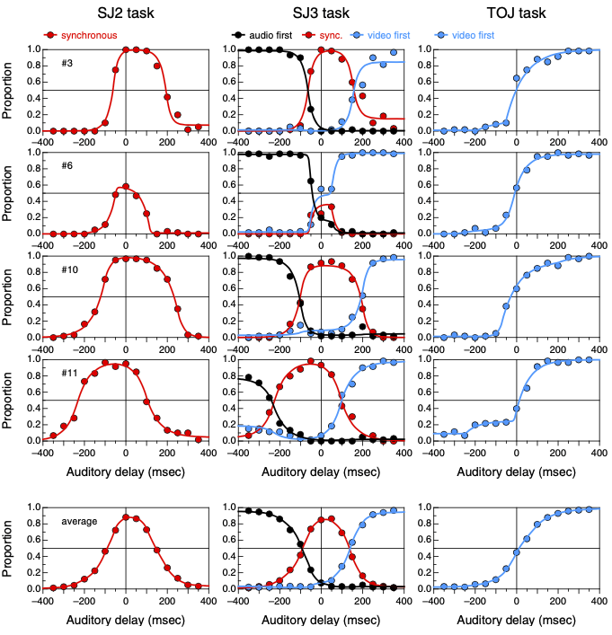
Model Predictions (separate fits)
Notes:
These are the model predictions, shown by curves, when the data from the three tasks are fitted separately. The first two rows are two participants’ data and model predictions; the last row is the group average.
The model predictions seem to be pretty good, but if we look at the estimated parameters,

Slide 20
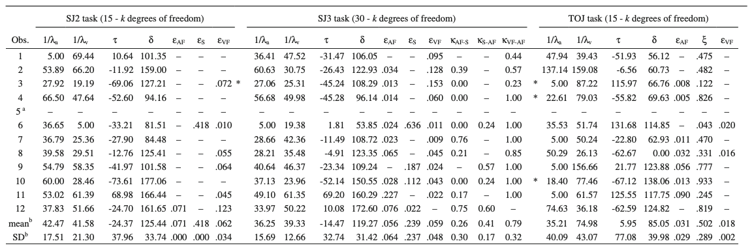
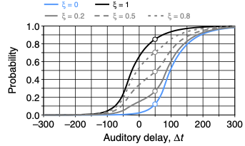

Parameter estimates (separate fits)
Stimuli: flash-click
There is a trade-off between $ξ$ and $τ$!
Notes:
They did a bunch of stats on the estimated lambda, tau and delta, in order to test if they differ significantly across the three tasks. I am not gonna go over those stats because the estimated parameters for the TOJ task probably do not reflect the underlying true value.
Look at this row for example. The estimated parameter for responding visual-first is so low that it’s hard to believe. If there is some tiny bit of preference for reporting ‘A-first’, that’s acceptable. But 0.04 is almost unlikely. If we go back and look at this subject’s data, the PSS of the curve looks very unbiased to me. So what’s happening is there is a trade-off between this response bias parameter and tau, which represents the systematic transmission delay in auditory signals relative to visual.
This figure shows what the curve would look like at different levels of response bias. When this value is very small, we will get this blue curve, but having a positive tau will shift this blue curve to the left, so that the PSS can be aligned in the center again.
So there is a clear trade-off between these two parameters. If we look at tau and this response parameters of other participants, you will see that a large bias of reporting ’V-first’ and a negative value for tau; a small bias normally comes with a positive value for tau.
Yeah this is the biggest issue I see from this table. Another issue is that they do not constrain the lapse rate. Here for the SJ task, these two lapses rate even reached 0.4, meaning that 40% of times when participants intended to report ‘synchronous’, they accidentally reported ‘asynchronous’.

Slide 21
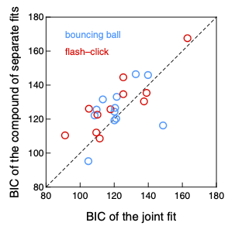
Model comparison (joint fits vs separate fits)
Free parameters:
Temporal order judgment (TOJ)
=
=
=
+7 alternative models
Synchrony judgment (SJ)
=
=
=
+7 alternative models
Ternary task (SJ3)
+3 alternative models
A total of 8 x 8 x 4 = 256 models!!!
Notes:
They also fitted the model jointly to the data from all these three tasks assuming a common lambda_a, lambda_ and tau. And again they tested alternative models in which some of the lapses are set to 0. So in total they tested 256 models!!! I was very impressed that they all the combinations of models. They then picked the best model for each participant based on BIC value.

Slide 22
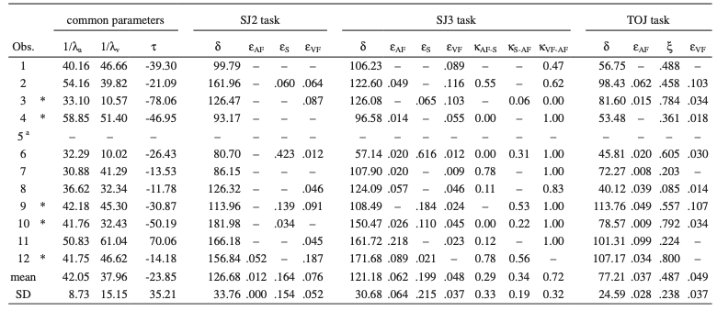
Parameter estimates (joint fits)
Notes:
These are the parameter estimates based on the joint fits. These three common parameters seem pretty stable (no value hitting the boundary as before) because there are more data constraining them. The response bias parameter for the TOJ task seems less extreme now because tau is better constrained given the data from the other two tasks.

Slide 23
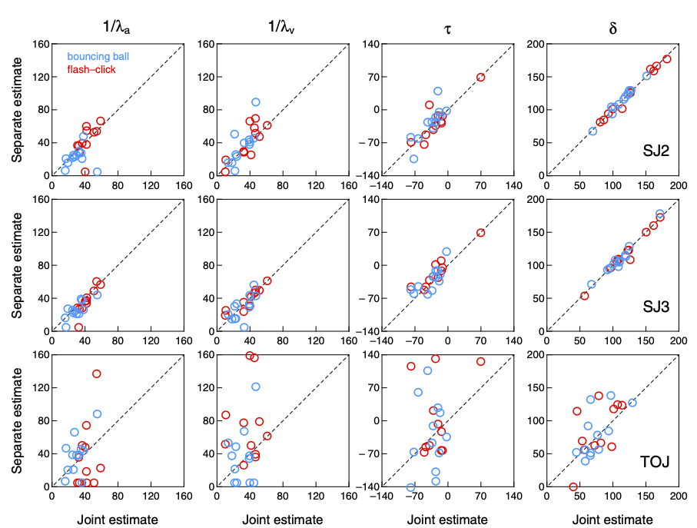
Comparison of parameter estimates
Notes:
Then they compared the estimated 1/lambda_a, 1/lambda_v, tau and delta based on the joint fits with the estimated values based on separate fits for each of these three tasks respectively. They conclude that the estimated parameters are more stable when the model is fitted jointly or separately for the synchrony judgment task as well as the ternary task, but not for the TOJ task. The authors consider this as a big shortcoming of the TOJ task.
I don’t really agree, because the estimated parameters don’t match well between the joint and separate fits because there is a clear trade-off between parameters.

